Slide 1
Unit 7 Generalized Linear models

Slide 2
Generalized linear models
In statistics, the generalized linear model (GLM) is a flexible generalization of ordinary linear regression that allows for response variables that have error distribution models other than a normal distribution. The GLM generalizes linear regression by allowing the linear model to be related to the response variable via a link function and by allowing the magnitude of the variance of each measurement to be a function of its predicted value (error is func of Y)
Generalized linear models were formulated as a way of unifying various other statistical models, including linear regression, logistic regression and Poisson regression.
Generalized linear models allow response variables to have arbitrary distributions (rather than simply normal distributions), and for an arbitrary function of the response variable (the link function) to vary linearly with the predicted values (rather than assuming that the response itself must vary linearly).
Linear regression assumes normal distribution for the noise term and constant variance for errors and thus for Y, possible violations can be when noise is not normal, relationship is not linear and Y can be only positive and discrete

Slide 3
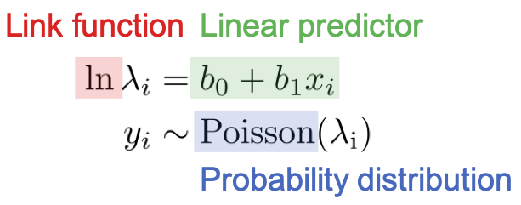
Generalized linear models
GLM has 3 components: 1) linear predictor 2) link function 3) probability distribution
Linear predictor is a linear combination of parameter b and explanatory variable x
Link function links the linear predictor and the parameter for probability distribution (e.g. for Poisson regression we have log link function, as parameter for Poisson regression must be (+)
The last component is the probability distribution, which generates the observed variable y (e.g. we have Poisson distribution here, so model is Poisson regression)
LM models are the generalization of the linear regression model. When we speak about this generalization. we mean that rather than forcing a linear relationship between the dependent and independent variables, it allows the dependent variable to be related with the independent variables through a link function
Here g is the link function through which we are relating
the variables. Depending on the problem we can choose
the link function to be logit, probit, linear

Slide 4
Generalized linear models (non-Gaussian distributions and non-linear functions)
Generalized linear model is an extension of linear regression model which allows data to be non-normally distributed.
Regression is a set of methods useful when you have a single dependent (or outcome) variable, and you want to explain or predict in terms of a set of independent variables
The most basic regression model and the one most commonly used is linear regression, this requires: a) dependent variable to be continuous b) relationship to be linear 3) errors to be independent
Generalized linear models refer to generalizations of a) when dependent variable is categorical, we may use logistic regression, or if the DV is a count we may want to use Poisson regression, if DV is a time to event then survival methods are appropriate
Generalizations of b) are called nonlinear regression

Slide 5
Objectives
Introduction to Generalized Linear Models; Exponential Families
At the end of this lecture, you will be able to
Recognize the two components, namely the noise distribution and the regression function , being generalized from linear models to form the generalized linear models .
Define appropriate link functions for a generalized linear model.
Define k-parameter exponential families of distributions.
Define canonical exponential families of distributions.
Compute the mean and variance of canonical exponential families in term of the log-partition function b

Slide 6
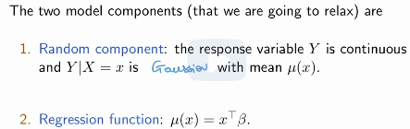
Generalizing Two Components of Linear Models
GLMs are extension of linear regression model, where we allow 1) non-Gaussian errors 2) non-linear relationships
Gaussian linear model assumes , 1) IID normal errors 2) that dependence (regression function- E[Y/X=x]) is linear
If our response variable is binary, the E[Y/X=x] should be in range (0,1)
We cannot write because then mu ranges through R
We need an invertible function f such that

Slide 7
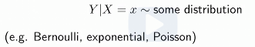
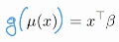
Generalizing the Linear Model; the Link Function
GLM generalizes normal linear regression models in the following directions:
Random component: noise is not normal
Regression function: is not linear
Where g is called link function and E[Y/X=x] is regression function
In this unit, we focus on generalized linear models, which is much more powerful and expressive family of models
As it turns out, this comes at a cost: finding the MLE becomes more difficult
We relax the assumption that regression function – mu is linear, instead we assume that g(mu) is linear for some function g so that
The function g is assumed to be known, and is referred to as the link function
Through an appropriate choice of the link function, which depends on the model, we will hope to be able to compute an estimator , usually the MLE

Slide 8
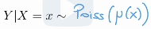
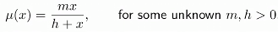
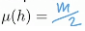
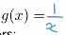
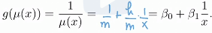
Predator-Prey Model: the Random Component and the Link Function
If Y>0 and discrete we can use the following model:
Regression function we assume to be: (flats off)
Where m – max expected daily preys that predator can cope with
h is the number of preys such that
Mu(x) is not linear but using reciprocal link: the RHS can be made linear in the parameters

Slide 9
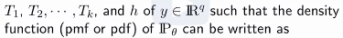
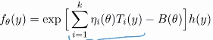
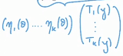
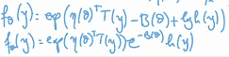
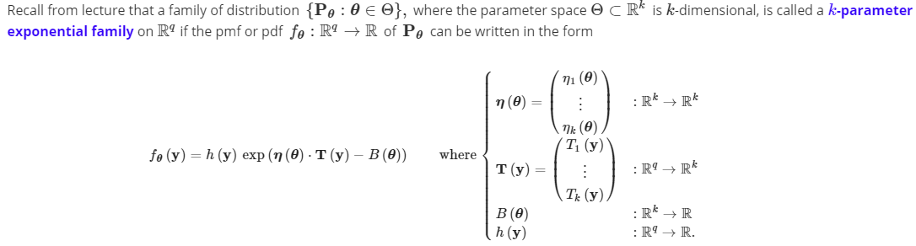
Exponential Families: Definition
Family of distribution is said to be a k-parameter exponential family on , if there exist real valued functions
and
PDF has form summation can be written as vector inner product
Or PDF can be written alternatively as:
So, in model we have k-dimensional parameter theta, and q-dimensional vector y
What’s crucial in this pdf/pmf is that the only way theta and y can interact is just by taking the product

Slide 10
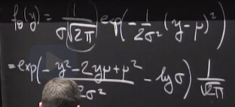
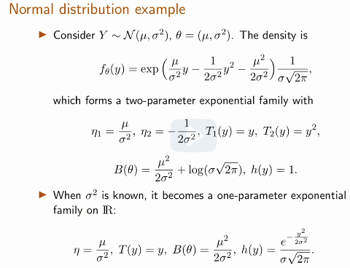
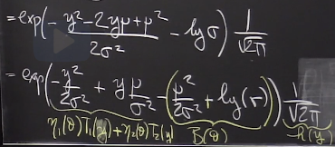
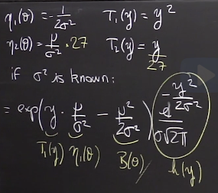
Normal distribution example
Example of conversion of PDF to exponential family form

Slide 11
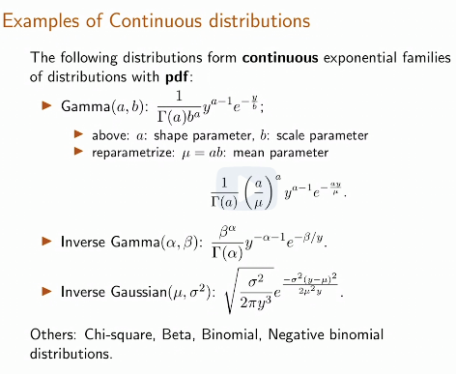
More examples of Continuous Distributions
a

Slide 12
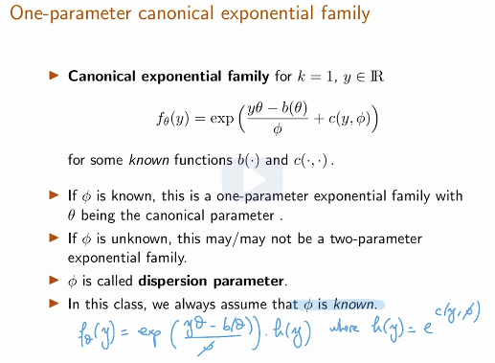
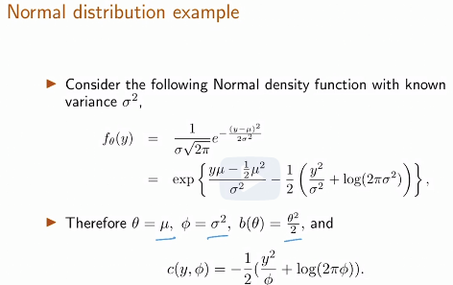
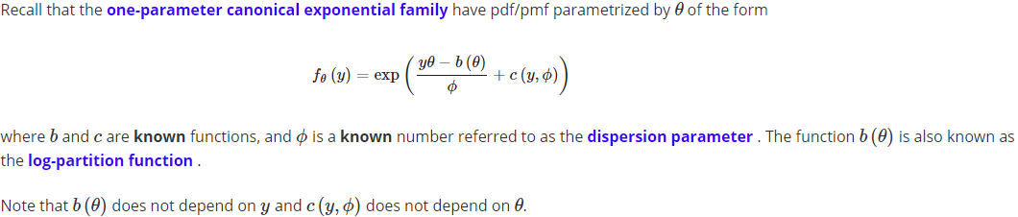
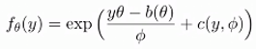
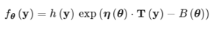
One-Parameter Canonical Exponential Families
A
When we have 1 parameter in distribution, we call exponential family canonical
It has slightly different form

Slide 13
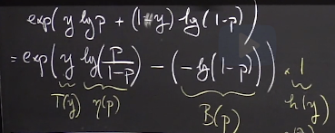
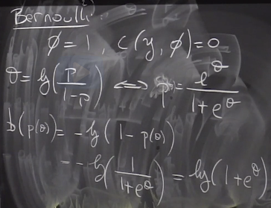
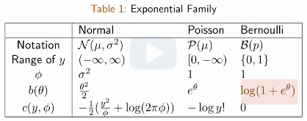
One-Parameter Canonical Exponential Families
Finding B for Bernoulli distribution

Slide 14
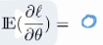
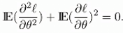
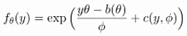
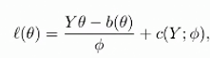
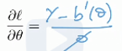
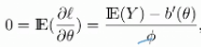
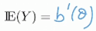
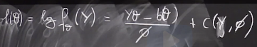
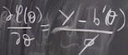
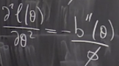
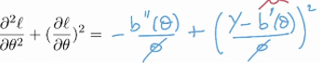
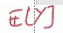
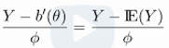
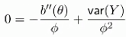
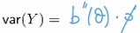
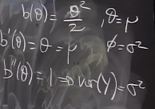
Expectation and variance in terms of the Canonical Parameters
Let denote the log-likelihood function, then mean and var of Y can be derived from the following identities: 1) 2) both are definitions of Fisher inf
if we take deriv of l(theta) ->
Earlier we had , so which leads to
So, if we are told that distribution comes from canonical exponential family, we need only derivative of b, in order to find the expected value of random variable
MLE does not depend on C, because when we take derivative it vanishes
->
a this term squared is var(Y), so we have then we have
Example for Gaussian

Slide 15
Lecture 22. GLM: Link Functions and the Canonical Link Function
Link Functions and the Canonical Link Function
Objectives
Understand and identify link functions for generalized linear models .
Understand and identify the canonical link function for a given exponential family.
Find the maximum likelihood estimate for a generalized linear model with a canonical exponential family.
Understand the strict concavity of the log-likelihood when the link function is the canonical link function.
Understand that asymptotic normality holds for GLMs under usual conditions for asymptotic normality of the MLE.

Slide 16
Exponential family wikipedia
Exponential family is a parametric set of probability distributions of a certain form
This special form is chosen for mathematical convenience, based on some useful algebraic properties, as well as for generality, as exponential families are in a sense very natural sets of distributions to consider.
Exponential families include many of the most common distributions. Among many others, exponential families includes the following: normal, exponential, gamma, chi-squared, beta, Dirichlet, Bernoulli, Poisson, geometric
A number of common distributions are exponential families, but only when certain parameters are fixed and known (e.g. Binomial with fixed n, Multinomial with fixed n)
Example of common distributions that are not exponential families are Student’s t, most mixture distributions, family of uniform distributions

Slide 17
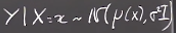
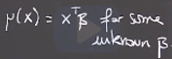
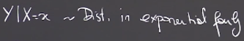
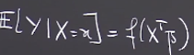
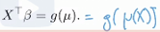
Recap: Generalized Linear Model and Link Function
For linear model we assumed that Y/X=x has normal distribution
And regression function E[Y/X=x] is assumed to be linear
For GLM
We say distribution of Y/X=x belongs to exponential family
E[Y/X=x]=f(x’b) we are interested in question of how to pick f
Based on distribution we choose, we need to carefully pick f, so that f applied to x’b corresponds to possible values of y (0,1 in Bernoulli distribution)
Exponential family is a family that has a very specific way of having the parameter of theta and the random variable y interacting in the form of PMF/PDF
Specific shape of distribution in the exponential family is going to depend on some b, c, phi
When using MLE for exponential family, we maximize MLE wrt to theta and we want this theta to depend on the actual x, otherwise that would not be regression
Beta is parameter of interest, and needs to appear in the likelihood function to use MLE
Link function g relates the linear predictor X’b to the mean mu

Slide 18
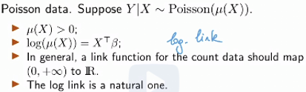
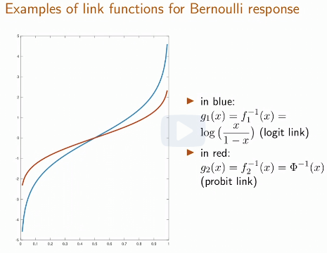


Examples of Link Functions: Log, Logit, Probit
Link functions are used to make sure f(mu) has range in real line
For linear model: g(mu)=1, as Y already has range R
For Poisson data: Y is >0 so we need to map from + R to entire R, we use log function for that
For Bernoulli/Binomial data: Y is between 0 and 1, so 1st we map from (0,1) to +R, then from +R to entire R: 2 choices: 1) logit 2) probit (inverse CDF of normal)

Slide 19




The Canonical Link Function
Canonical- conforming to a general rule or acceptable procedure
Link function for given distribution can have many forms, but canonical needs to be precise
Canonical link function , on top of the requirement to where regression function (mu(x)) lived to the entire line, where x transpose beta lives, needs to consider the distrib of y given x; so we need to consider both link function and random component
Procedure for getting canonical link: 1) write down distribution in
Canonical exponential form that us b 2) take derivative of b and invert
This function 3) this inverted function will be the canonical link function

Slide 20







Canonical link function for Bernoulli distribution
So, we write down canonical exp form
For particular distribution (by writing down PMF/PDF and then
Transforming it into canonical form)
Having transformed PMF/PDF to canonical form, we identify
Theta and b(theta) (e.g. for Bernoulli
We express b(theta) in a form so that b is a function of theta
Then we find derivative of b(theta) and invert this function, so that theta is a function of mu
Then this inverted function is canonical link function
For other distributions we have:

Slide 21


GLM and Introduction of Beta for Estimation
If we know the link function, the random component and the fact that Y is member of canonical exponential family, then we know everything we need about conditional distribution of Y given X
We can actually write the likelihood of Y/X, it is going to be a function of the only unknown parameter beta
Once we have data, we will try to
estimate beta with MLE
We will have a separate model for
each Yi depending on Xi and theta_i
Theta’s are going to be linked together
through the beta vector/matrix
But if we want to find beta using MLE, we need
To have only 1 unknown, so we need to express
Theta as function of beta

Slide 22





GLM and Introduction of Beta for Estimation
Advantage of using the canonical link is that function h turns out to be identity

Slide 23


Log-Likelihood for Exponential Families
So, we need to replace theta with
X’*beta, we use b(theta) from exp family

Slide 24




Strict Concavity of Log-Likelihood when the Link is the Canonical Link
Now, we want to find MLE, so we should take gradient wrt to beta, equate it to 0 and to make sure that it is maximizer, we need to take 2nd derivative and ensure that the hessian matrix is negative definite
B’’ is var (so +), (X’X)^2 is and phi is +; we have – in front
So, overall 2nd derivative is negative – concave function
Gradient of log likelihood

Slide 25

Concluding Remarks on MLE for GLMs
Maximum likelihood estimator for Bernoulli Y and the logit link function is called logistic regression
In general, there is no closed form for the MLE and we have to use optimization algorithms (e.g. gradient descent (for large scale problems), Newton’s method)
The asymptotic normality of the MLE also applies to GLMs

Slide 26


Recitation 26. Poisson and Gamma Generalized Linear Models
In GLMs we specify some distribution for Yi, then express mean of Yi as linear function of Xi’s, but we also apply link function to E[Y]
Exponential family form makes easier to think about GLMs and have common framework
And then use specifically canonical form
Having canonical form will help us to figure
out what the link function should be
In this recitation we wrote: 1) general form
Of GLMs
2) Poisson PMF in its usual form
3) Poisson PMF in exponential and canonical
Forms
4) Calculated mean and variance of
Poisson’s distribution using canonical form
So that verify that our canonical PMF is
correct

Slide 27









Recitation 26. Poisson and Gamma Generalized Linear Models
We recall canonical form for Poisson PMF
And recover theta from there
In GLMs we need to have
And in our case g(lyam) is
So, we get lyamda= e^theta, then we
Have:
Having substituted parameter of Poisson
Lyamda as function of theta, which is
We can express PMF in new form and
Write down likelihood:

Slide 28

Recitation 26. Poisson and Gamma Generalized Linear Models
To find MLE, we take derivative of log likel and equate it to 0, we assume that X is a row vector
Beta that maximizes MLE from solving grad(l)=0, does not have closed form, but we can use optimization algorithms
Finally, we want to show that beta’s found above are maximizers, that is function is concave
To do that, we find 2nd derivative of log likel
and it equals to A*A’ which is symmetric matrix
and has all positive eigenvalues, so –A*A’ –
negative eigenvalues, so concave function
A matrix is said to be symmetric if the matrix
Is square and its transpose is equal to itself

Slide 29


Recitation 26. Poisson and Gamma Generalized Linear Models
No, we aim to find CI for beta
To do that, earlier we have found beta_mle, so we have
That is asymptotically centralized MLE estimator converges to Normal distribution with mean 0 and variance= inverse of FI; then we multiply by sqrt(FI) and get N(0,1)
Having done that, we can use 2 methods for
Finding out CI for beta if we simplify multivariate
Beta to bivariate case
1st method is just go with N(0,1) separately
As beta_1 and beta_2 are independent and
We get square region
2nd method is to square the estimator and
Get Chi-squared distribution and get disc-shaped
region

Slide 30

Recitation 26. Poisson and Gamma Generalized Linear Models
Now, we discuss how to estimate sqrt(FI)
To find that, we need to find 1st FI, we use estimator for Fisher information
As FI is defined through expected values, we can replace that with averages, and in place of beta’s we insert MLE estimates for beta’s
Another way is to square the estimator
And thus we will get Chi-squared distribution
And specify confidence region for that value
We will get a sphere region for beta

Slide 31




Recitation 26. Poisson and Gamma Generalized Linear Models
Now, we discuss the issue of overdispersion that we can observe in our dataset, that is a lot more variation happening in response variables, than actually Poisson distribution is able to account for (because in Poisson, mean=var), so in those cases we can use Gamma distribution
So, we write down PDF of gamma distribution in its usual and canonical form and identify parameters b(theta) and phi
We know that and we got
Last equality from canonical form
As mean equals to b
Then we express parameter b in terms of
Theta, which equals to X*beta
To make sure that variance if positive,
We incorporate – into beta or we can use
Different link function

Slide 32

Recitation 27. Hypothesis tests for logistic regression
We can use linear regression, but we can have predictions outside range of (0,1)
We can choose a lot of different ways of parametrizing PMF in terms of some real number for GLM problems, but canonical setup leads to concave loss function when finding out MLE, so we can optimize it easily
In logistic reg, we choose Y
to be Ber(p) and write PMF in
Canonical form and identify
Theta and b(theta)
Then we replace p with theta
substitute X’*beta in place of
theta and get new PMF
Having PMF, we use MLE to
Find optimal beta’s (argmax b)
We will do hypothesis test using
Wald’s test and likelihood ratio test

Slide 33




Recitation 27. Hypothesis tests for logistic regression
We are interested in doing hypothesis test for beta, specifically only 1 bj
We have asymptotically normality leading to multivariate gaussian, so to get the variance for bj^ we need to extract j’th diagonal element of covariance matrix
So, we start with MLE conv to N(0,I^-1)
Then we normalize variance to 1 by multip
By sqrt(I) and squaring test statistics and we
Get Chi-sq d
We plug in theta^ in FI as Slutsky allows it
We take jth diag coordinate of var as we
Are interested in bj not whole beta vector
In next video we will talk about why
Plug in FI works
Video 3

Slide 34

Recitation 27. Hypothesis tests for logistic regression
Here we calculate the Fisher information matrix
1st we find 1st derivative of log likelihood wrt to ith parameter, then 2nd derivative

Slide 35

Recitation 27. Hypothesis tests for logistic regression
Likelihood ratio test

Slide 36
Insight from exercises
Write down canonical link form
Express mean through theta
Write pmf through theta, but substitute x*b to theta
Write down likelihood
Take derivative wrt to betai’s, find optimal values for beta’s
Theta=x*b; replace theta through mean, calculate mean given x and b

Slide 37
Overview of Units 6 and 7
Unit 6. Linear Regression
Lecture 19. Goal of Regression, theoretical and empirical linear regression solutions
Lecture 20. Multivariate linear regression
Recitations: 1) Hypothesis testing for linear regression 2) Multiple hypothesis testing and Bonferroni correction 3) Ridge regression
Unit 7. Generalized Linear models
Lecture 21: Introduction to generalized linear models; exponential families
Lecture 22: GLM: Link functions and the Canonical link function
Recitations: 1) Poisson and Gamma Generalized Linear models 2) Hypothesis test for logistic regression

Slide 38


Review unit 6
Goals of regression: 1) identify whether there is a relationship between X and Y (hypothesis test for coefficient) 2) Error bars around predictions (var(Y)) 3) Error bars around coefficients (var for coeff)
Modeling assumptions in regression: 1) X and Y’s are iid 2) X and Y have some joint distrib, from which we can determ they have some relationship or indep
We are usually interested in predicting value of Y at particular value of X, so Y/X
Finding conditional distribution is hard, instead we determine some statistics of that distribution like mean, median, quantile, variance etc
Regression function is E[Y/X=x], as we do not always have a point at particular x, we use neighboring points… actually when we do regression, we get information from all the points to estimate E[Y/X=x] at 1 point
Our aim is to find f(x)=E[Y/X=x], we can fit many functions of this type, our choice here is
Having chosen linear function for regression, we find it by minimizing the squared distance between Y and Y^ we find a and b by taking derivatives and equating to 0

Slide 39






Review unit 6
Clearly, the points will not lie exactly on the fitted line, as Y=aX+b+e, var(Y/X=x)=var(e) , so var(Y)>0 as var ( e) >0, and noise e should satisfy and
In practice we estimate a* and b* from data by min, so we have
In multivariate case, X is a vector 1st term in X vector is 1
Linear indep c1v1+c2v2!=0; span – smallest subspace cont. the set, rank is dim of span
Matrix calculus is similar to scalar calculus, except we need to be aware of dimension match. LSE=min (Y-X*b)^2; we need to find b, so 2*X’(Y-X*b)=0; X’Y=X’Xb;
We get system of p linear equations, to solve, we invert it, important that X’X is invertib
So it should have rank p (n>=p), if n<p, then b is not unique
Geometric intuition: Y’ is the orthogonal projection of Y onto column space of X, that is hyperplane formed by X*beta, to find projection of Y onto X*beta, we write X*b=PY, and substituting expression for b we then have P is
To verify that P is projection matrix, we check P^2=P

Slide 40












Review unit 6
In deterministic design for LR, we assume that the design matrix X is deterministic, so only random component is e
To make an inference (confidence regions, tests), we need more assumptions: 1) design matrix has rank p 2) errors are iid and var(e)=const 3) noise is N(o, sigma^2)
So, having made these assumptions we can find elements of
Vector b by using MLE and it comes down to LSE,
That is to maximize MLE, we need to minimize
so, for Gaussian noise LSE=MLE
Distribution of beta* which

Slide 41




Review unit 6
Significance tests on beta^, here by testing specific beta_j, we can see whether the variable xj has any impact on prediction
So, to do hypothesis test, we need the distrib of beta^ and normalize it ( as we do not know its variance, we will plug its unbiased estimator
We get t distribution – (N/sqrt(Chi))
With test-statistic
If we do hypothesis test for several
Betas at the same time, and considering
They are independent, and all for the same level alpha, by chance we may reject H0, to make this analysis correct we need to reduce quantiles, so that it considers the number of variables in the test (if more than 1 variable, q_alpha should be reduced), so level is a/m, where a is desired level alpha, m is the number of hypotheses
Linear regression is about correlations, not causality, random Gaussian noise assumption, we can test this assumption using Kolgomorov - Smirnov test

Slide 42
Review unit 7
GLMs are generalization of ordinary linear regression that allows for response variables that have error distribution models other than a normal distribution
GLM generalizes linear regression by allowing the linear model to be related to the response variable via a link function, it is formulated as a way of unifying other statistical models, including linear, logistic and Poisson regression
GLMs allow response variables to have arbitrary distributions (rather than only normal) and for an arbitrary function of the response variable (via link function) to vary linearly with the predicted values, so non-linearity and non-normality
GLM g(Y)=X*beta has 3 components: 1) linear predictor (X*beta) 2) link function g links E[Y] and linear combination of X’s (X*beta) 3) probability distribution for Y
The most basic regression model and the one most commonly used is linear regression, this requires: a) dependent variable to be continuous b) relationship to be linear 3) errors to be independent and normal
Although GLM generalizes LR, the cost is that it becomes harder to find MLE
We will assume some model for noise/Y, depend on that we will choose the link function

Slide 43

Review unit 7
Family of distribution with k-dimensional parameter, is said to be k-parameter exponential family on , if there exists real valued functions
and
When we have 1 parameter in distribution, we
Call exponential family canonical, it has slightly diff
Form
In canonical form :
Exponential family is a parametric set of probability distributions of certain form, this certain form is chosen for mathematical convenience, as well as for generality
They include normal, exponential, gamma, Bernoulli, poisson etc and not include uniform, student’s t etc; Whereas for linear models we assumed Y/X=x to be normal and E[Y/X=x] to be linear, for GLM Y/X=x is exponential and E[Y/X=x]=f(x’b)

Slide 44

Review unit 7
We are interested in picking the link function given certain distribution from exponential family (shape of specific exp depends on shape factors b, c, phi)
When using MLE for exponential family, we maximize MLE wrt to theta and we want this theta to depend on the actual x, whereas beta is parameter of interest and needs to appear in the likelihood function to use in MLE
Link function g relates the linear predictor X’b to mean mu and it needs to be cont and diff
Link functions are used to make sure f(mu) has range in real line for linear g(mu)=1
Poisson – input +R, output entire R – log function
Bernoulli: input 0,1- output entire R –probit(inv CDF)
Or logit
Link function for given distribution can have many
Forms, but canonical link func needs to be precise, on
Top mapping to entire R, it should also cons the distrib
Of Y given x, so need to cons both link func, rand comp

Slide 45





Review unit 7
Procedure for getting canonical link function: 1) write down distribution in canonical exponential form that uses b 2) take derivative of b and invert this function 3) this inverted function will be the canonical link function. 1)Mu=b’ 2) g(mu)=theta 3) g(b’(theta))=theta, so g=b’^-1
If we know the link function, the random component and the fact that Y is a member of canonical exponential family, then we know everything we need about conditional distribution of Y given X; so we can write the likelihood of Y/X, it is going to be a function of the only unknown parameter beta, once getting data, we estimate beta with MLE
Log likelihood for exponential families:
For canonical link function h= identity
And theta=X’*beta and b(theta) from exp family
Now we want to find MLE, so we should take gradient wrt to beta, equate it to 0 and to make sure that it is maximizer, so 2nd derivative/hessian matrix is negative
Gradient Hessian: b’’ is var so +, X’X is +, phi is +
and we have - in front, so overall expression is negative - concave

Slide 46

Review unit 7
In GLMs we 1) specify some distribution for Yi, then express some function (link) of mean of Yi through linear function of Xi’s
Exponential family form makes easier to think about GLMs and have common canonical form, so that it is easier to find canonical link function through b’^-1
To find beta’s through MLE: 1) write down PMF for given distribution in canonical form 2) identify theta and b(theta) 3) use to express mean of distrib through theta
4) Use this substitution to write PMF/PDF to find MLE and use theta=X*beta
To find MLE find dl/dbeta=0; then find dl^2/dbeta^2 prove it is concave
To find confidence interval for beta^, we use and normalize it by multiplying to I^0.5, so that we have N(0,1)
If we want to test 2 or more beta’s simultaneously, we can use either separate hypothesis tests or Chi-squared test
But how to estimate FI^0.5, we can use estimator for FI, as FI is defined through expect values, we can replace those with avgs and in place of beta’s we insert MLE estim for b
Adv of using canonical setup for GLM is that it leads to concave loss function

